Slide 1


Slide 2
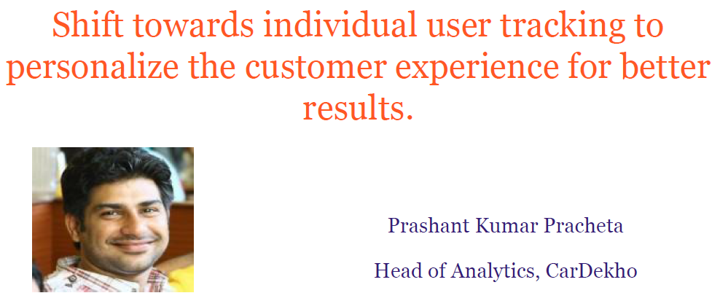

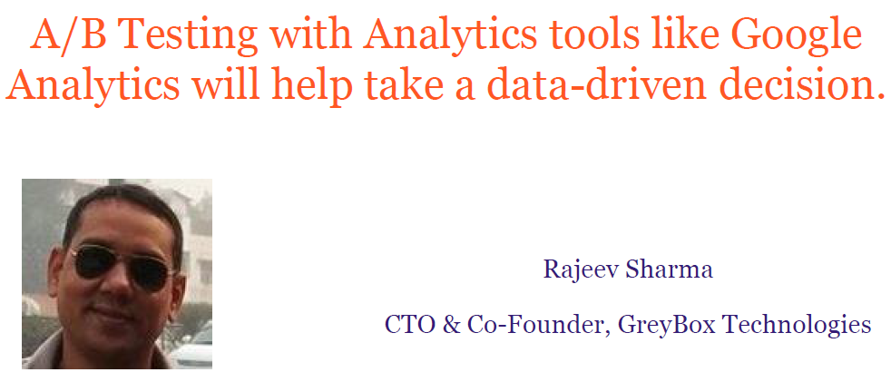
Why
Web Analytics ?
improve online results, whatever they are...

Slide 3
Web Analytics
Web analytics is the measurement, collection, analysis and reporting of internet data for purposes of understanding and analysing for decision making.
What type of data can be collected from web site visits?
How can this data be collected?
What are the potential problems with collecting data?
What analysis can be done on this data?
What information do you want about how your website is being used?
What data can you collect from your website?
How can you analyse the data?
Can this give you the information you want?

Slide 4

What kind of information can you find out?
How people find your site :
What search engine do they use?
What search terms do they use?
What sites refer visitors to my site?
How people navigate your site
What content are they most interested in?
Where do people drop out of the site?

Slide 5
What kind of information can you find out?
How people become customers
What part of my web site is most effective at generating sales?
What are the conversion rates (number of sales) based on traffic from different sites?
Where are the customers located?

Slide 6
Metrics for Measuring web performance
Metrics:
It is a good idea to identify metrics which you can track to access if your web site is working.
Which metrics are suitable depends on the nature of the site:
eCommerce, Social Networking

Slide 7
Key Metrics
General
Views
Visits
Bounce Rate
Conversion Rate
Time on Site
New vs. Returning Visitors
Depth of Visit
Generally trends will be more interesting than absolute numbers.
Non Commerce Sites
Loyalty
How much content is consumed
Engagement of web applications (RIA)

Slide 8
Some Examples of metrics
Conversion Rate:
Did visitors do what you wanted them to do?
Buy something, download a catalogue, join your mailing list, watch a video ?
Average order size (for e-commerce).
Average time spent per visit for other types of site.
Abandonment Rate
Number of shopping carts abandoned.
Number of registrations not completed.
Content Rating by visitors.

Slide 9
Exercise
What metrics do you think the college could use for our college web site?

Slide 10
Remember all of this is complex information.
Need to consider whether you can collect the data to generate this information.

Slide 11

How is data collected?
Script Based Tracking
Server logs

Slide 12
Script Based Tracking
Some code (normally Java script) is added to each page.
This code can collect additional information and send it back to the server.
for example: Information about the screen size, partial form completion.
The page tagging service manages the process of assigning cookies to visitors.
Page tagging can report on events which do not involve a request to the web server
Eg. such as interactions within Flash movies or partial form completion
The technology is usually provided as part of a hosted solution and website owners can access real time reports online without needing any additional hardware or software in-house.

Slide 13
Server logs
These are log files which contain a history of activity on a web server.
Data saved generally includes:
IP address of the client
User name if logging on is necessary.
Date and Time
Page of file requested
Number of bytes returned,
Browser the client used
URL of page which contains the link
Any cookies.
Any errors

Slide 14
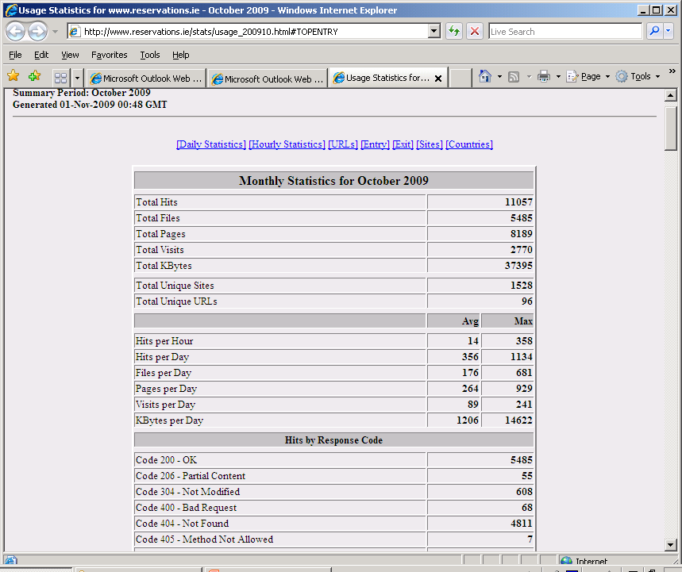

Slide 15
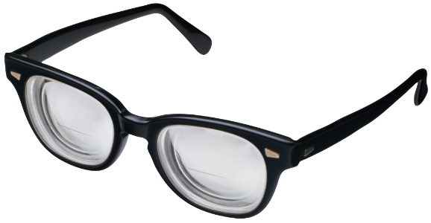
Analysis
Need to get beyond basic statistics in order to understand the data.
May need to analyse data based on different dimensions.
E.g. data accessed, geographic region, total spend, traffic type, browser used, new verus repeat visitors.
May use external data in order to interpret the data.
E.g. Any external marketing campaigns.

Slide 16
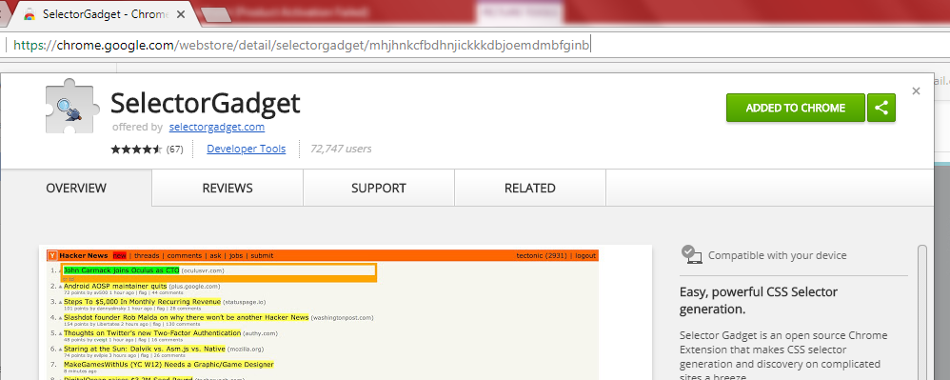
Prerequisite before starting with R
URL
Click here

Slide 17
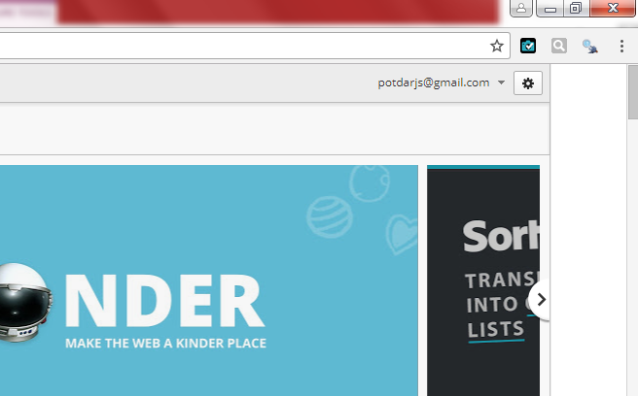
Prerequisite before starting with R
Selector Gadget Tool will appear here

Slide 18

Starting with R
Install required package
“rvest”

Slide 19
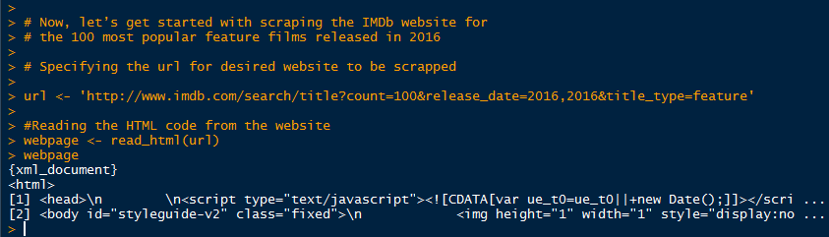
Web Analytics with R –
Reading HTML code from the IMDb website
Specify URL
Read HTML Code
HTML doc

Slide 20
Aim…
# we’ll be scraping the following data from this website.
# • Rank: The rank of the film from 1 to 100
# • Title: The title of the feature film.
# • Description: The description of the feature film.
# • Runtime: The duration of the feature film.
# • Genre: The genre of the feature film,
# • Rating: The IMDb rating of the feature film.
# • Metascore: The metascore on IMDb website for the feature film.
# • Votes: Votes cast in favor of the feature film.
# • Gross_Earning_in_Mil: The gross earnings of the feature film in millions.
# • Director: The main director of the feature film. Note, in case of multiple directors, I’ll take only the first.
# • Actor: The main actor of the feature film. Note, in case of multiple actors, I’ll take only the first.

Slide 21
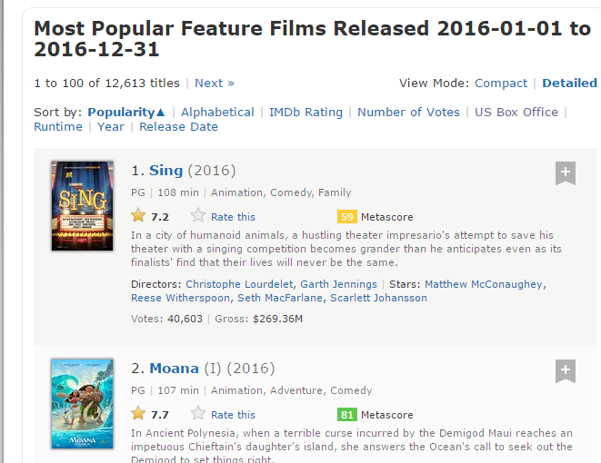
Using the Selector Gadget to know CSS selector
Open the below Link in Google Chrome
http://www.imdb.com/search/title?count=100&release_date=2016,2016&title_type=feature

Slide 22
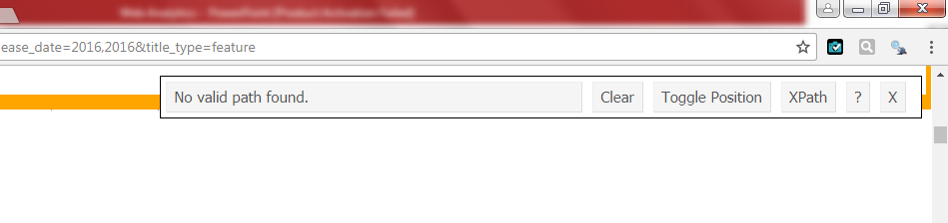
Using the Selector Gadget to know CSS selector
Open the below Link in Google Chrome
http://www.imdb.com/search/title?count=100&release_date=2016,2016&title_type=feature
Click on Selector Gadget
This window will pop up

Slide 23
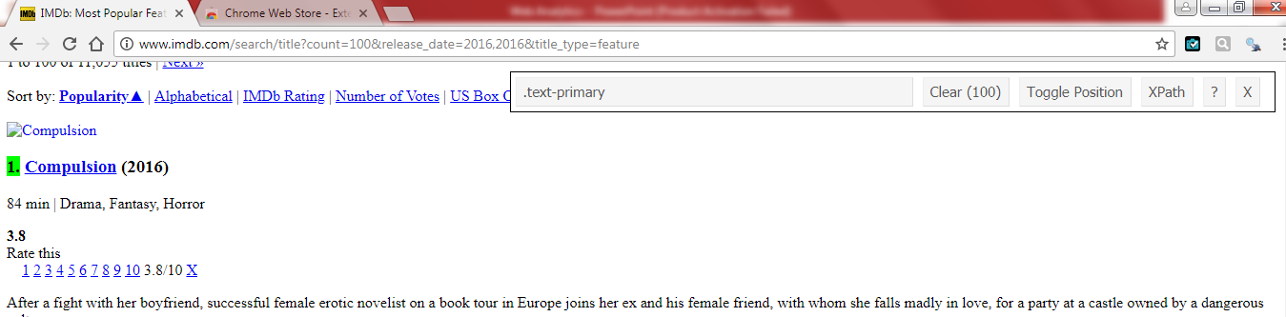

Using the Selector Gadget to know CSS selector
Open the below Link in Google Chrome
http://www.imdb.com/search/title?count=100&release_date=2016,2016&title_type=feature
Select the Ranking Field with cursor. It will get highlighted
Such text will appear here. Copy this CSS selector

Slide 24
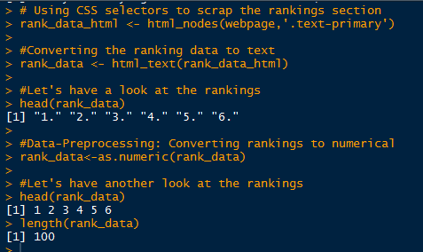
Scrap the Ranking Section using CSS Selector
Paste the CSS selector
Getting Rank data
Rank data in raw form
Processing it

Slide 25
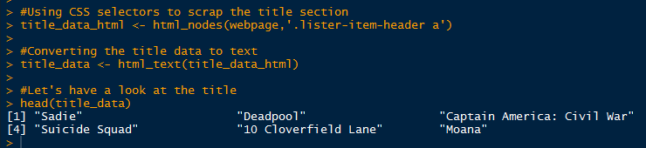
Scrap the Title Section using CSS Selector
CSS selector
Getting Rank data
Title data

Slide 26
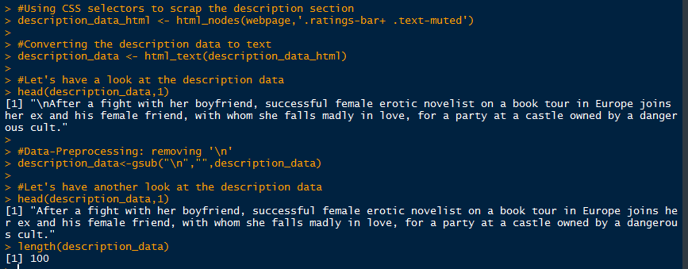
Scrap the Description Section using CSS Selector

Slide 27
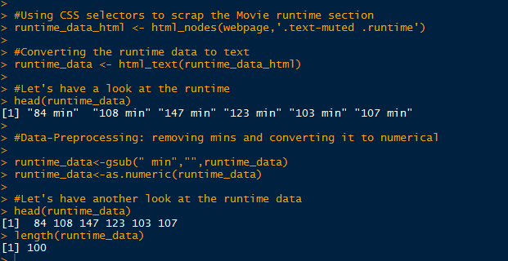
Scrap the Runtime Section using CSS Selector

Slide 28
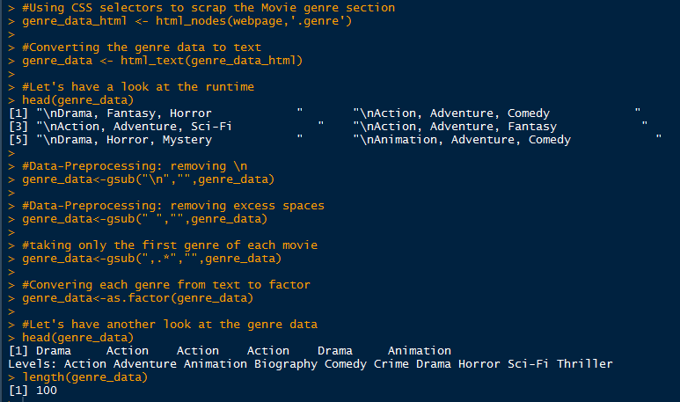
Scrap the Genre Section using CSS Selector

Slide 29
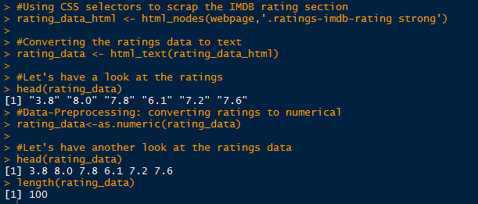
Scrap the Rating Section using CSS Selector

Slide 30
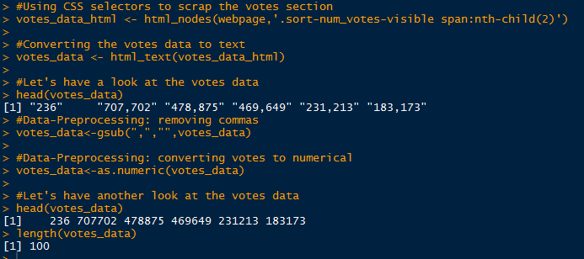
Scrap the Votes Section using CSS Selector

Slide 31
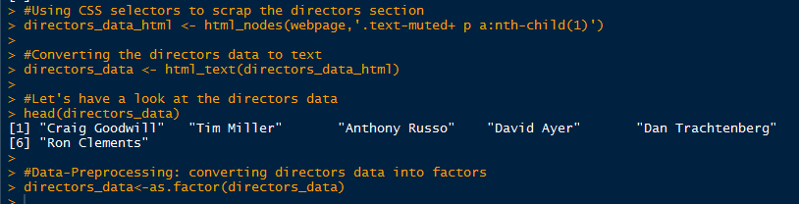
Scrap the Directors Section using CSS Selector

Slide 32
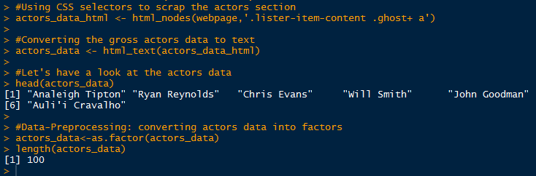
Scrap the Actor Section using CSS Selector

Slide 33
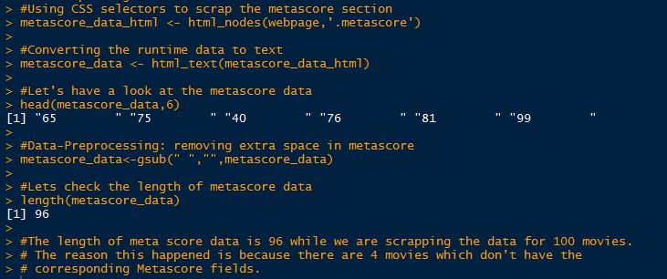
Scrap the Metascore Section using CSS Selector

Slide 34
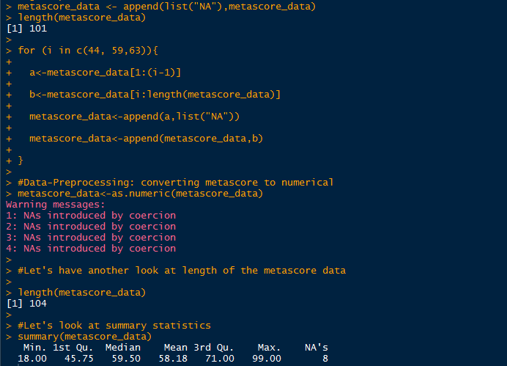
Scrap the Metascore Section using CSS Selector

Slide 35
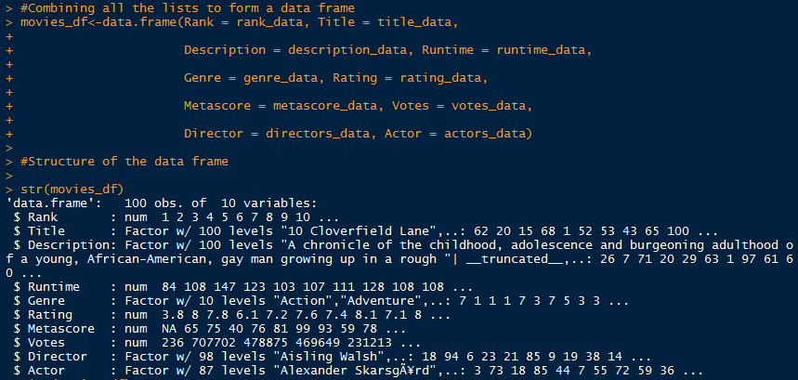
Combining the captured data in to a single data frame

Slide 36

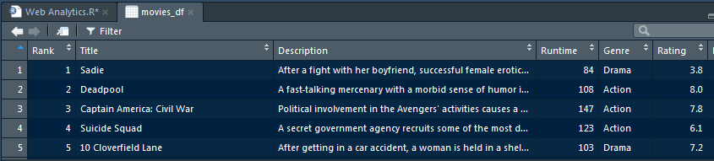
Now we have successfully scrapped the IMDb website for the 100 most popular feature films

Slide 37

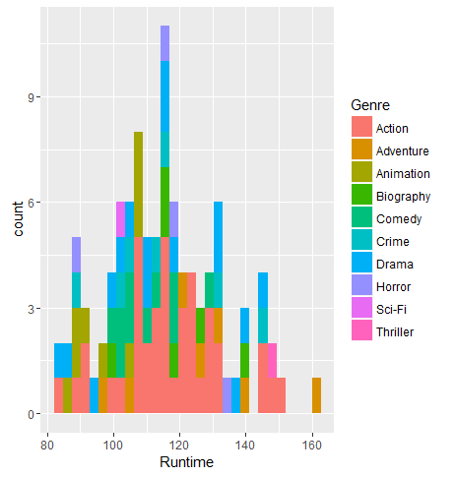
Analyzing the scrapped data from the web

Slide 38

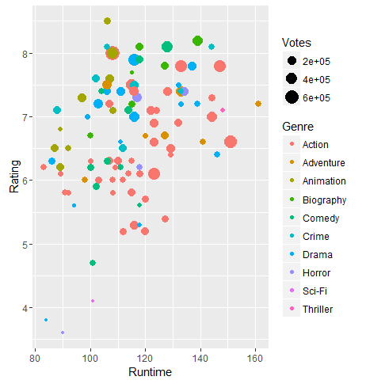
Analyzing the scrapped data from the web

Slide 39
Web Analytics: Tools and Case Studies
Tools
VisiStat - www.visistat.com
Web Analytics Case Studies
Communications Provider - TuVox.com
Online Retailer - TicketsByInternet.com
Winery & Entertainment Venue - The Mountain Winery
Non-Profit Organization - SFBallet.org
Public Relations & Media Agency - BLASTmedia
Technology Provider for Real Estate Professionals - Pullan.com
Real Estate Agency - Intero Real Estate
Start-Up Online Business - GuruPrint.com

